Slide 1
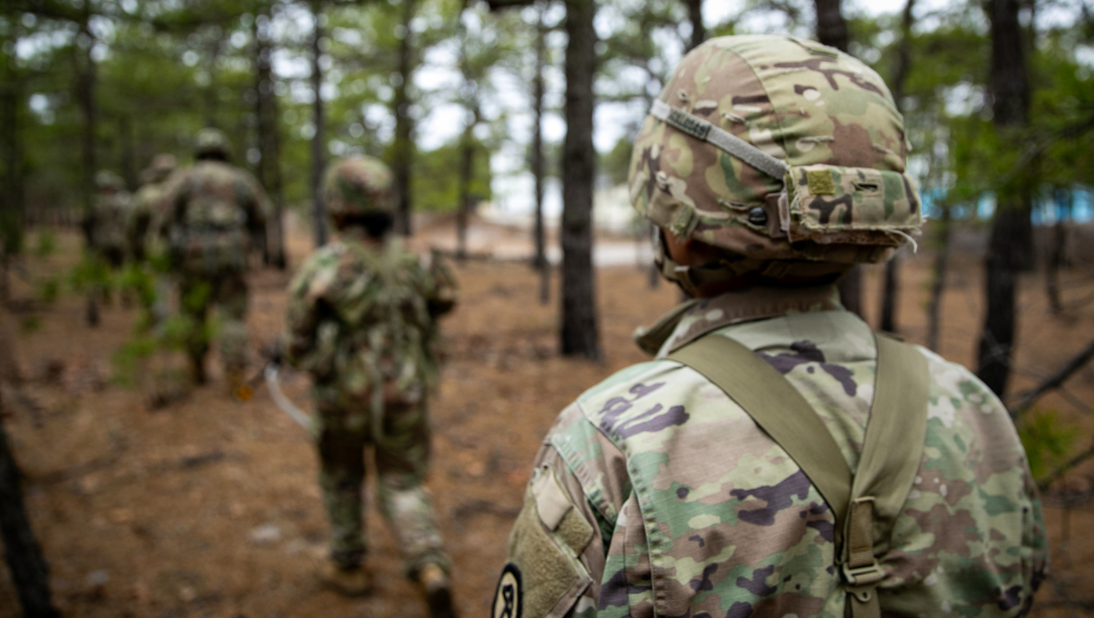

U.S. Army Tank-automotive and Armaments Command
OIB LEADERSHIP:
OUR CONTRIBUTIONS TO GROUND COMBAT VEHICLES
12 AUG 2026

Slide 2

AGENDA
UNCLASSIFIED
Opening Remarks: BG Beth Behn, TACOM Commanding General
Organic Industrial Base Representatives:
              Anniston Army Depot, Ms. Abby Quinn, Deputy Commander
              Sierra Army Depot, LTC Shivnesh Kumar, Commander
              Rock-Island Arsenal – Joint Manufacturing and Technology Center,
              COL Eloy Martinez, Commander
              Red River Army Depot, COL Christopher Masson, Commander
Q&A
Closing Remarks: BG Beth Behn, TACOM Commanding General
DISTRIBUTION STATEMENT A. Approved for Public Release.
UNCLASSIFIED
2

Slide 3


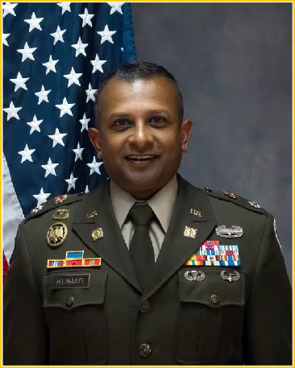
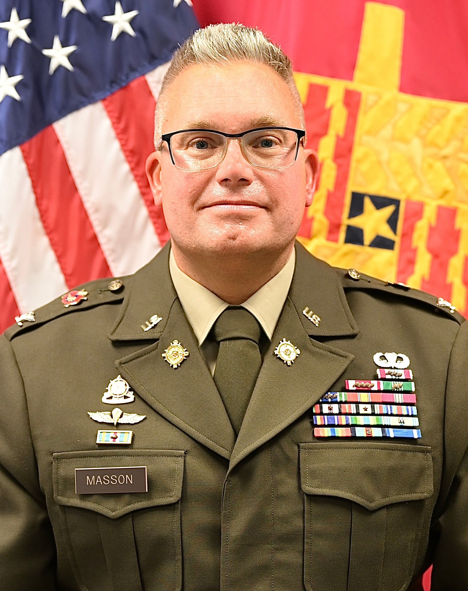
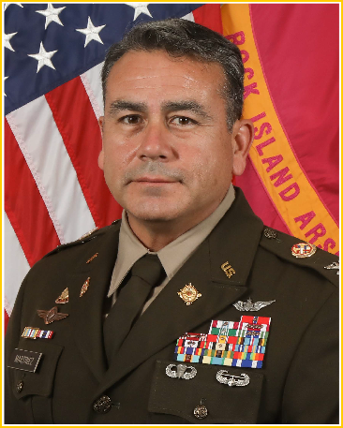
OIB LEADERSHIP MODERATOR AND PANEL MEMBERS
U.S. Army
Tank-automotive &
Armaments Command
BG BETH A. BEHN
Commander
Moderator
Anniston Army Depot ABBY QUINN
Deputy to the Commander
Sierra Army Depot
LTC SHIVNESH KUMAR
Commander
Red River Army Depot
COL CHRISTOPHER MASSON
Commander
Rock Island Arsenal - JMTC COL ELOY MARTINEZ
Commander

Slide 4
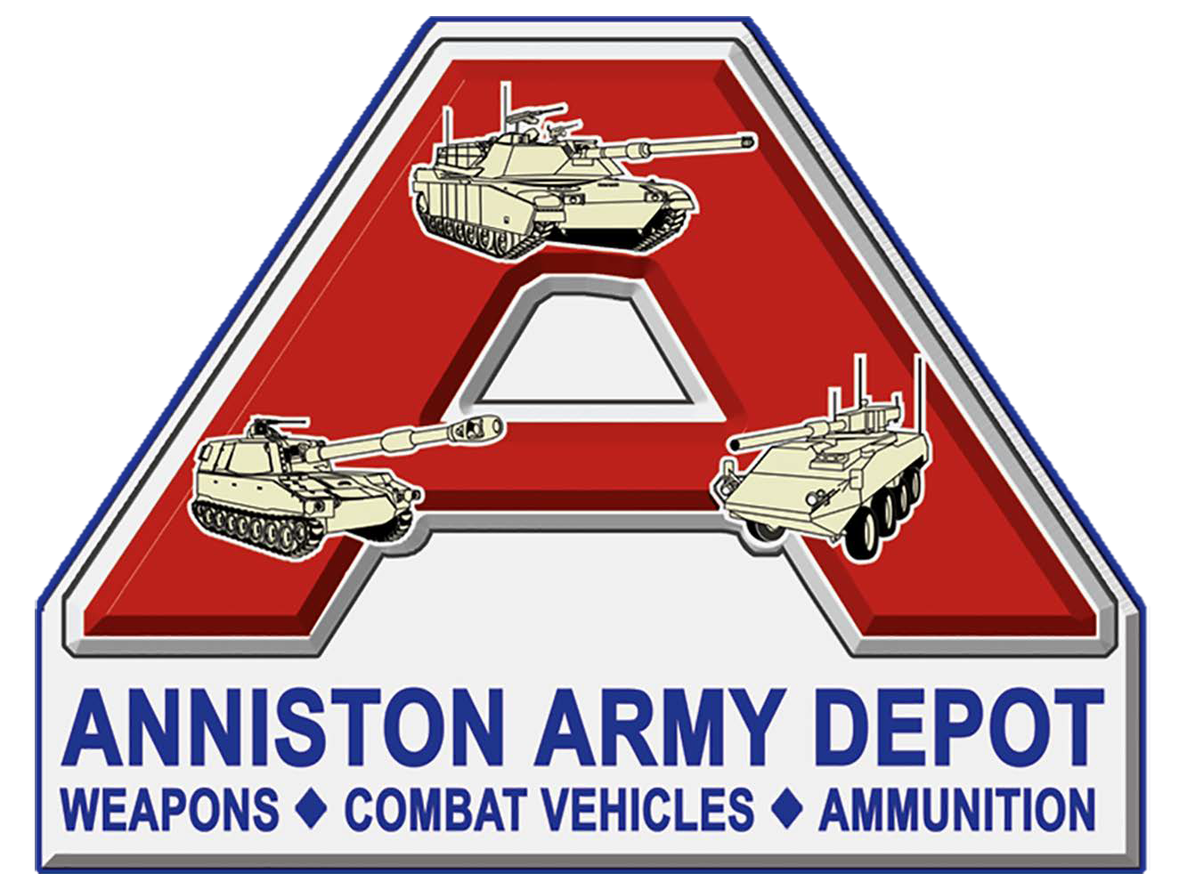
ABBY S. QUINN, Deputy to the Commander
ANNISTON
ARMY DEPOT

Slide 5

TACOM: ANNISTON ARMY DEPOT
UNCLASSIFIED
ANAD’s Support to OIB Modernization: Capabilities to offer:
Custom machining
Combat vehicles (except Bradley)
Overhaul/repair of all wheeled and tracked vehicles
Artillery overhaul/repair
Small arms overhaul/repair
Bridging systems overhaul/repair
Overhaul/repair of locomotives, rail equipment and non-tactical generators
Worldwide support
Opportunities for Partnership (3–5-year outlook):
Production Support to XM-30
Production Support to Mobile Tactical Cannon
Production Support to Joint Assault Bridge Follow-On Contract
DISTRIBUTION STATEMENT A. Approved for Public Release.
UNCLASSIFIED
5

Slide 6
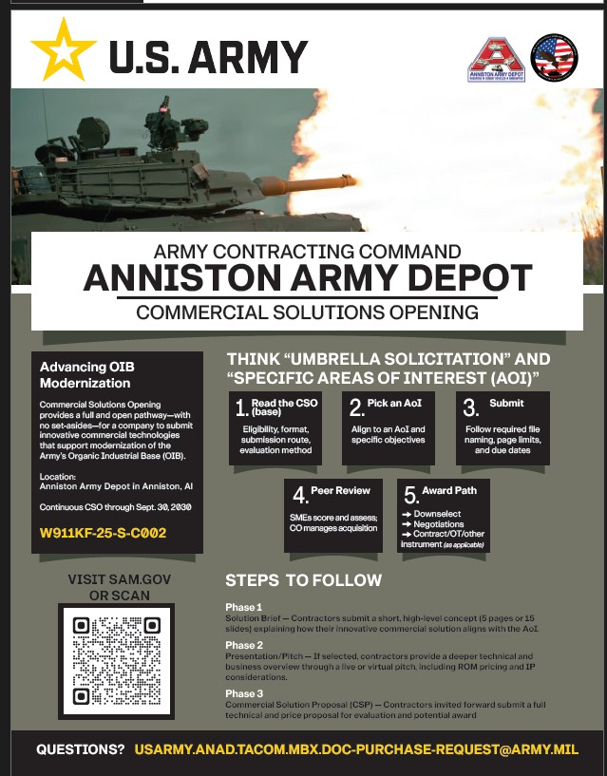
UNCLASSIFIED
ACC-DTA: ANNISTON ARMY DEPOT
Contract Number: W911KF-25-S-C002
CSO Open: Through Sept 30, 2030
Ongoing AOIs:
Agile / Flexible Facilities
Connected Digital Enterprise (CDE)
Advanced Manufacturing
Paint Process
Automation
Advanced Analytics
Workforce Development
Human Capital
Tire Process
Inventory Process
Energy and Chemical
Closed AOIs:
Diminishing Manufacturing Sources and Material Shortages (DMSMS), Obsolescence Parts, Multi-Class Parts Search and Procurement for Anniston Army Depot’s “Performance to Promise”
Technical, Engineering, Program Management, Locomotive Support, and Integrated Logistics
DISTRIBUTION STATEMENT A. Approved for Public Release.
UNCLASSIFIED
6

Slide 7

LTC Shivnesh Kumar, Commander
SIERRA
ARMY DEPOT

Slide 8
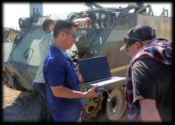
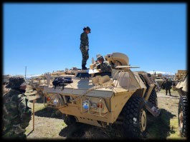
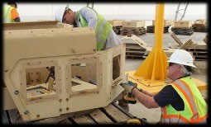
UNCLASSIFIED
TACOM: SIERRA ARMY DEPOT
SIAD’s Support to Ground Combat Vehicles:
Capabilities to offer:
Maintenance, Repair 10-20 for variety of GV
Care of Supplies in Storage (COSIS)
Paint, Blast, Coatings
Metal Fabrication, modification solutions
Storage (Free except touch time for Inventory, Environmental)
Naval Autonomous Data Collection System (NADACS)
Preservation and Packaging, Containerization and Assembly
Configuration management and assembly of kits
Value-Added Recovery and Harvesting
Logistics, Distribution and Fielding
Testing and Training, austere high-desert environment, Airfield Operations
Fly Away Teams for Worldwide support
Opportunities for Partnership (3–5-year outlook):
Petroleum and Water Systems (Production, maintenance, preservation & packaging, supply chain, fielding, storage)
End of First Life Center (FMS, kitting, harvesting, storage, value added recovery & fielding)
Airfield Operations
DISTRIBUTION STATEMENT A. Approved for Public Release.
UNCLASSIFIED
8

Slide 9
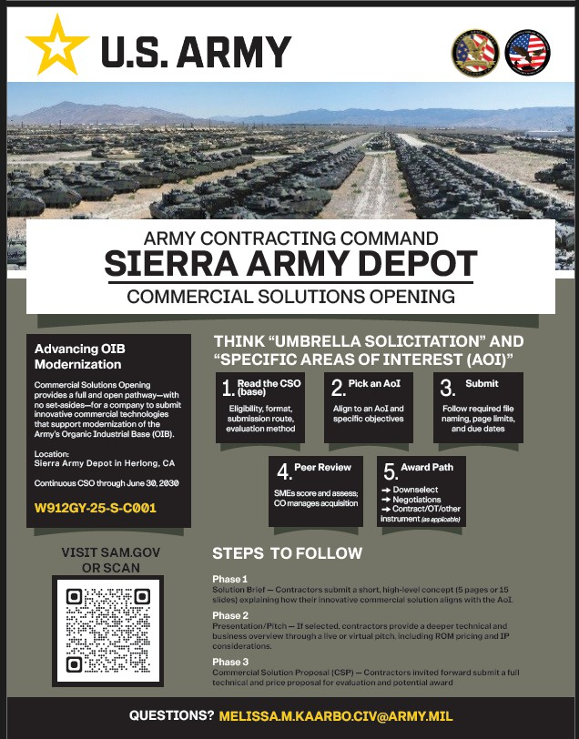
UNCLASSIFIED
ACC-DTA: SIERRA ARMY DEPOT
Contract Number: W912GY-25-S-C001
CSO Open: Through June 30, 2030
Ongoing AOIs:
Seeking new capabilities and operational constructs for manufacturing technologies to accelerate the capability to get advanced solutions to the Warfighter while enhancing and optimizing the Defense Manufacturing Base for today and tomorrow’s missions.
Closed AOIs:
None at this time.
Areas of Interest relating to SIAD’s needs
Agile & Adaptive Facilities
Advanced Manufacturing & Maintenance
Automation & Robotics
Logistics & Inventory Management Modernization
Airfield Maintenance
Energy, Environmental, and Chemical Management
Public-Private Partnerships (P3)
DISTRIBUTION STATEMENT A. Approved for Public Release.
UNCLASSIFIED
9

Slide 10

COL Eloy Martinez, Commander
ROCK ISLAND
ARSENAL
Joint Manufacturing and Technology Center

Slide 11
TACOM: ROCK ISLAND ARSENAL – JOINT MANUFACTURING AND TECHNOLOGY CENTER
UNCLASSIFIED
RIA-JMTC’s Support to OIB Modernization:
Capabilities to offer:
Foundry
Painting
Heat Treat
Assembly
Forging
Complex Machining/Grinding
Precision Welding
Pliable Materials
CNC Machining
Advanced/Additive Manufacturing
Test & Laboratory Services
Military Specification Plating
Spring Production
Engineering Services
Obsolescence Manufacturing
Opportunities for Partnership (3–5-year outlook):
Vertically Integrated– From raw material to finished assembly under one roof
AS9100 Certified as of June 2025
Open CNC machining capacity
DISTRIBUTION STATEMENT A. Approved for Public Release.
UNCLASSIFIED
11

Slide 12
UNCLASSIFIED
ACC-DTA: ROCK ISLAND ARSENAL – JOINT MANUFACTURING AND TECHNOLOGY CENTER
AMC’s CSO Advanced Manufacturing
Areas of Interest relating to RIA-JMTC’s needs:
Robotics and Automation
Automation and hazardous operations (blasting, grinding, forge part handling)
Additive manufacturing (3D Printing)
Advanced Materials
Advanced Non-destructive Testing and Inspection
Cornerstone OTA: Potential opportunities next FY for Modernization and Infrastructure
Closed: Forging Annex and Quality Assurance and Calibration Facility
Raw Material and Hardware
Steel, copper, aluminum
DISTRIBUTION STATEMENT A. Approved for Public Release.
UNCLASSIFIED
12

Slide 13

COL Christopher Masson, Commander
RED RIVER
ARMY DEPOT

Slide 14
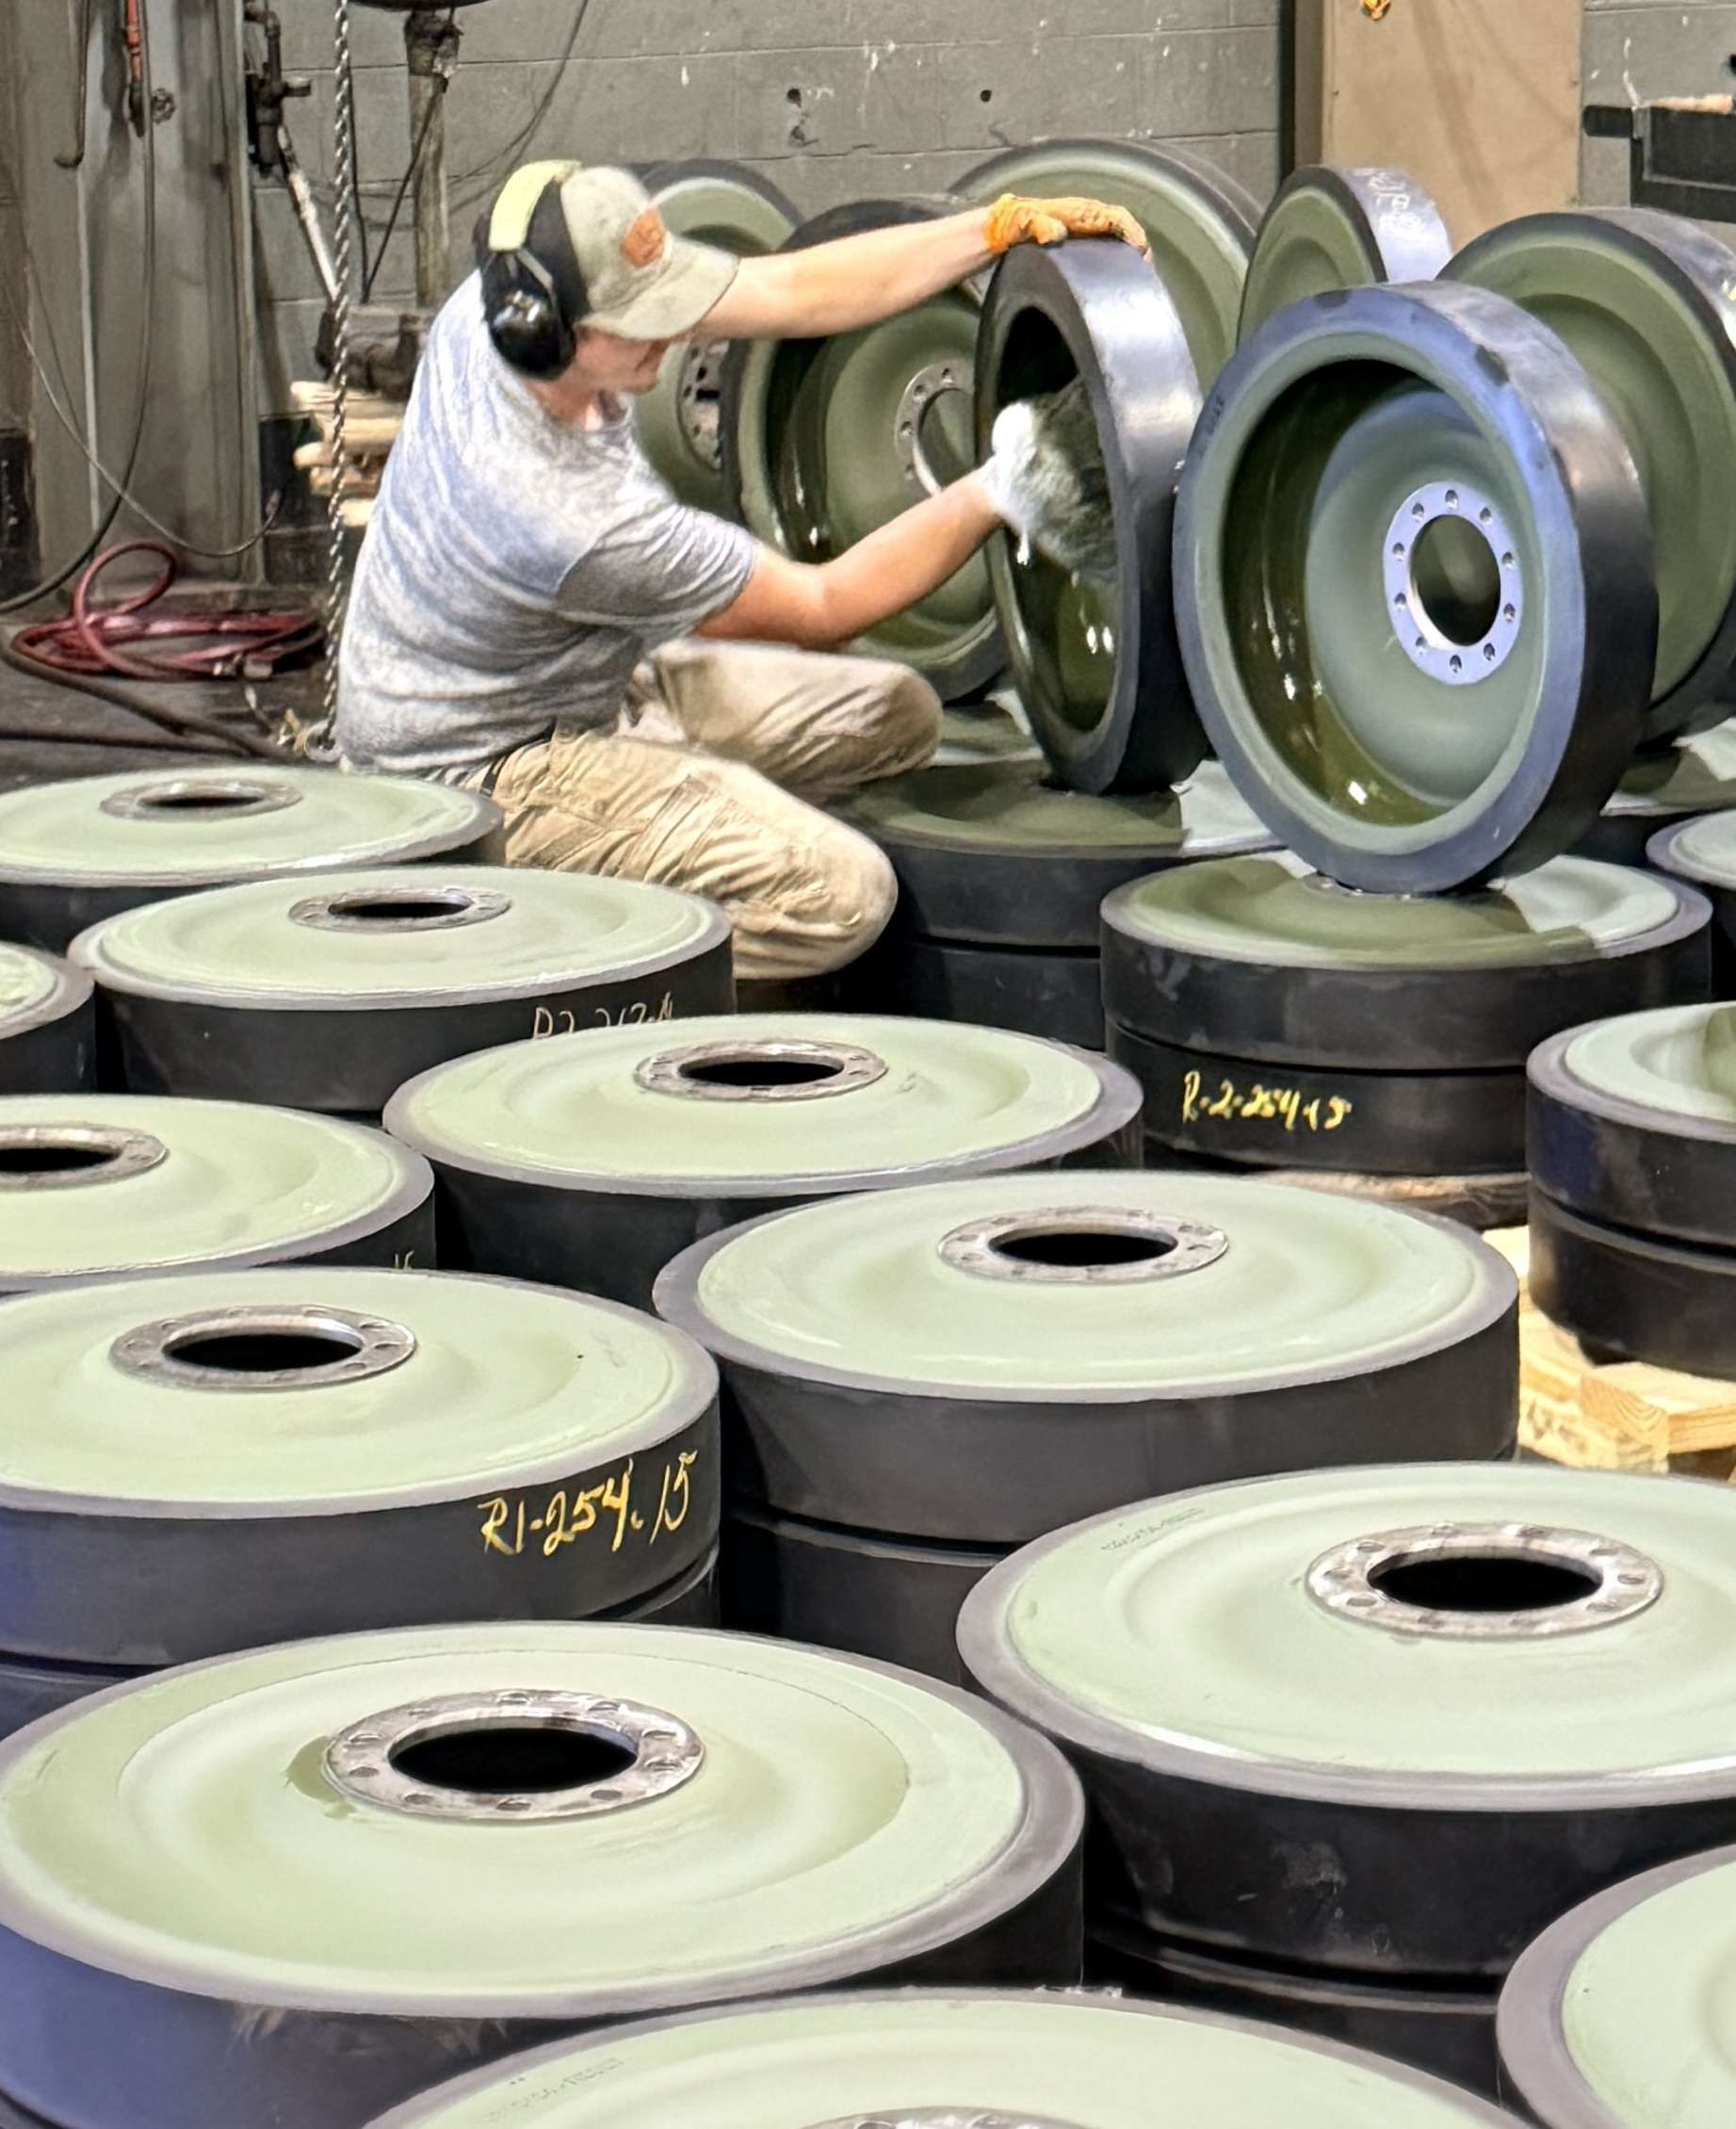
TACOM: RED RIVER ARMY DEPOT
UNCLASSIFIED
RRAD’s Support to OIB Modernization:
Strategy into Depot Execution, transitioning from a reactive repair facility to a predictive, data-driven industrial hub.
Modernizing the Floor for Multi-Domain Operations, upgrading our infrastructure and integrating advanced manufacturing, robotics, and automation to support both current and next-generation systems.
Shifting to a Strategic Partnership Model, changing our industry interaction model to become a strategic partner early in the acquisition lifecycle, helping to mitigate risks and fill critical manufacturing gaps.
Capabilities:
Full-scale industrial complex for remanufacture and refurbishment of all light, medium, and heavy tactical vehicles.
Combat Platforms: Bradley Fighting Vehicle, Multiple Launch Rocket System (MLRS), and High Mobility Artillery Rocket System (HIMARS).
Advanced Technologies: sUAS & UAV component manufacturing and repair (coming soon)
Remanufacturing: 100s of secondary items and components.
Opportunities for Partnership (3–5-year outlook):
sUAS Production to meet the Army’s Drone Dominance demands. We offer our facilities and skilled workforce to reduce startup costs, Cap-ex, and accelerate time-to-market.
Innovative Partnerships actively pursuing Public-Private Partnerships (P3s) and other agreements to co-invest in dual-use infrastructure and emerging technologies.
DISTRIBUTION STATEMENT A. Approved for Public Release.
UNCLASSIFIED
14

Slide 15
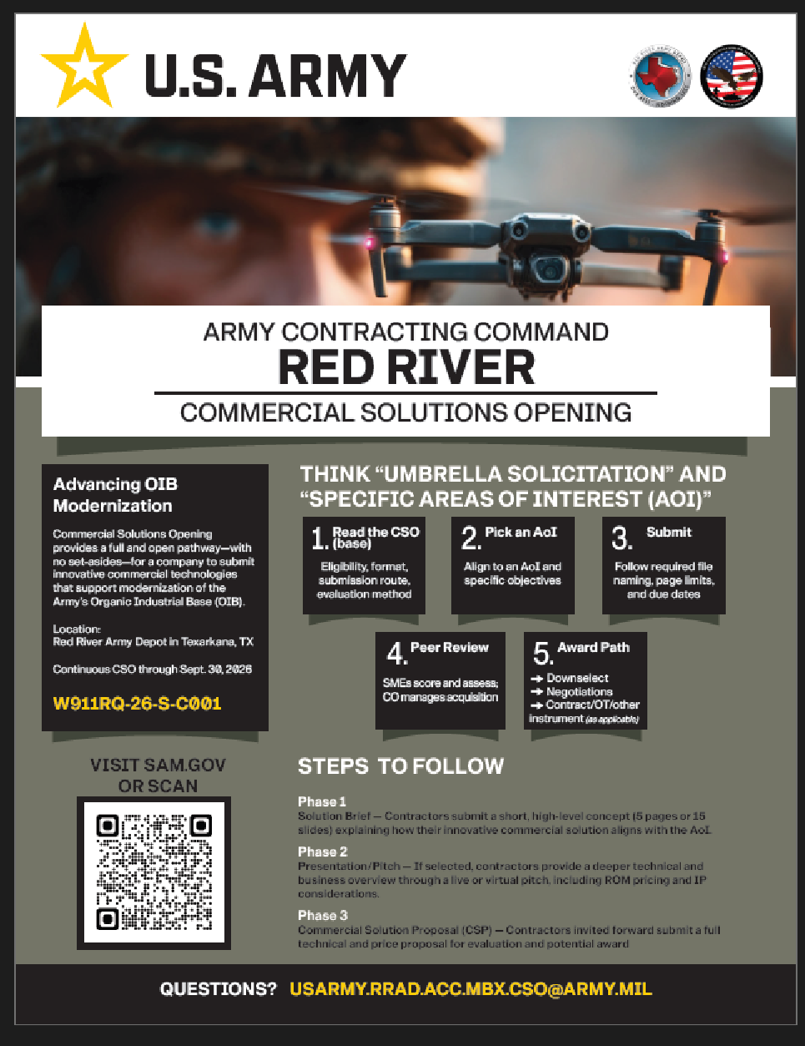
ACC-DTA: Red River Army Depot
UNCLASSIFIED
Contract Number: W911RQ-26-S-C001
CSO Open: Through Sept 30, 2027
Ongoing AOIs:
Agile / Flexible Facilities
Connected Digital Enterprise (CDE)
Advanced Manufacturing
Paint Process
Automation
Advanced Analytics
Workforce Development
Human Capital
Tire Process
Inventory Process
Energy and Chemical
Closed AOIs:
A008 Supplemental Labor Management
A009 DSB ATLAS Crane
DISTRIBUTION STATEMENT A. Approved for Public Release.
UNCLASSIFIED
15

Slide 16


